Slide 1

Metropolitan Beaches Commission Summit on Equity, Diversity & Inclusion
June 18 , 2022
Sen. Brendan Crighton & Rep. Adrian Madaro
Metropolitan Beaches Commission Co-Chairs
Chris Mancini & Bruce Berman
Save the Harbor/Save the Bay

Slide 2
After releasing reports in 2008 and 2014 on maintenance and infrastructure improvements on our region’s public beaches, the Commission began to examine all aspects of its work through a lens of racial justice and equity.

Slide 3
As protests against police brutality and systemic racism were breaking out across the country, the MBC scheduled public hearings on racial injustice in our own backyard.

Slide 4
As we began our hearings, it quickly became clear that the perceptions people of color have of our public beaches have been shaped by their personal experiences and those of their friends and families, who reported feeling unwelcome and being uncomfortable at the beach.

Slide 5
Those perceptions were also influenced by historic and current images of violence and conflict on our beaches, with which we are all familiar.

Slide 6
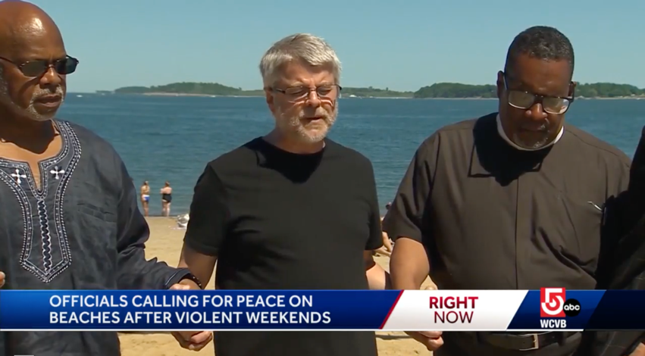
Instead of focusing on them, we have chosen to share this recent image of community leaders and law enforcement officials joining hands in a prayer for peace on our beaches.
Notes:
https://www.wcvb.com/article/clergy-call-for-peace-on-massachusetts-beaches/40136488 ← screenshot from

Slide 7
And reaffirm our commitment to equity, diversity and inclusive access to our region's public beaches.
Notes:
https://www.wcvb.com/article/clergy-call-for-peace-on-massachusetts-beaches/40136488 ← screenshot from

Slide 8
Following this Summit, the Commission intends to present our recommendations and a statement of our shared vision and values for the Metropolitan Beaches to the Legislature, the Administration, the Department of Conservation & Recreation and the public.
Please share your thoughts and comments with us by email to info@savetheharbor.org

Slide 9
MBC Hearing #1
Improving Beach Access for People of Color
May 6, 2021

Slide 10
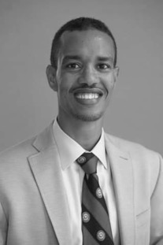
Abdi Ali
“Free cultural activities are really important. When I hear music that is relevant and inviting to me, I feel welcome and comfortable in that public space.”
East Boston Anti-Racism Community Coalition

Slide 11
Following the first hearing, the Metropolitan Beaches Commission and Save the Harbor/Save the Bay
Increased diversity on the Metropolitan Beaches Commission
Increased outreach to people of color, people with disabilities, and people who do not speak English as their primary language.
Worked with our youth development and community partners to provide free life jackets and water safety instruction to kids of color, who are 6 times as likely to die from drowning as white kids.
Expanded our Better Beaches Program Partnership with DCR, funding 40 new program partners and scores of new free beach events to improve beach access for people of color, people with disabilities, and people who do not speak English as their first language.

Slide 12
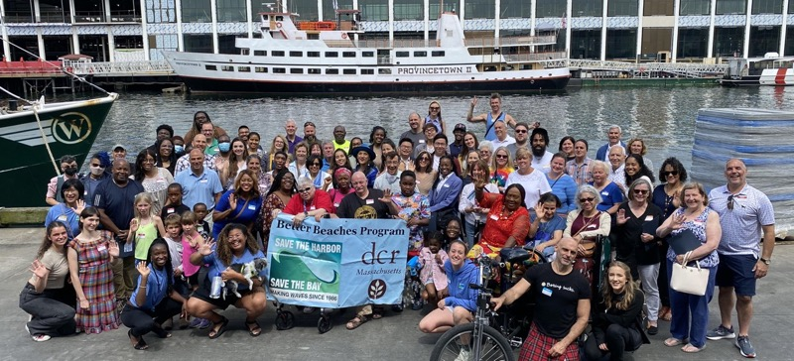
We increased the diversity of our Better Beaches Program Partnership with DCR, adding 40 new program partners.
You can find a complete list of 2022 Better Beaches Program Partnership Grant Recipients and a calendar of events at blog.savetheharbor.org

Slide 13
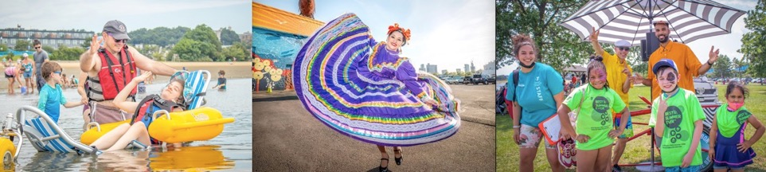
In 2022 we awarded more than $250,000 in Better Beaches Program grants to 62 organizations and creatives to support 100 free beach events and programs in 9 communities
including major grants to support Triangle Inc.’s Beach:Ability, performances by The Veronica Robles Cultural Center and A Trike Called Funk.

Slide 14
It’s time to hear
from you.

Slide 15
MBC Hearing #2
Improving Beach Access for People with Disabilities
November 30, 2021

Slide 16
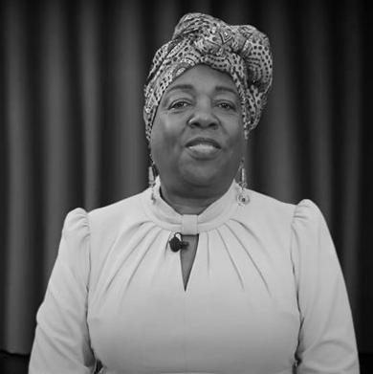
Colonel (Retired)
Andrea Gayle-Bennett
“Disabilities can make it hard to access areas that do not have ramps, accessible walkways and bathrooms. Accessibility to the beach is limited to those with physical disabilities. This turns them into spectators instead of participants.”
Disabled American Veterans
Department of Massachusetts
Notes:
“Disabilities can make it hard to access areas that do not have ramps, accessible walkways and bathrooms … Lynn is a city of over 100,000 residents,yet accessibility to the beach is limited to those with physical disabilities … this makes access to the full beach limited and it turns them into spectators instead of participants.”

Slide 17
Following the second hearing, the Metropolitan Beaches Commission and Save the Harbor/Save the Bay:
Purchased “Mobility Mats” and beach wheelchairs, so that people with physical disabilities can have access to the beach and the water.
Worked with the Department of Conservation & Recreation to secure funds to repair and maintain ramps, stairways and paths on our region’s public beaches, which in many instances present obstacles to access for people with disabilities, older adults and parents with strollers.
Hosted beach clean-ups in the region’s waterfront neighborhoods and beachfront communities, to help DCR remove truckloads of sand, stones, trash, weeds and debris from rails, trails and paths.

Slide 18
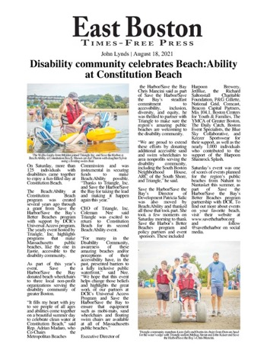
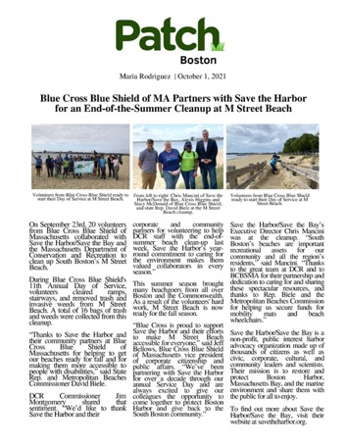

Slide 19
It’s time to hear
from you.

Slide 20
MBC Hearing #3
Overcoming Language Barriers to Beach Access
February 9, 2022

Slide 21
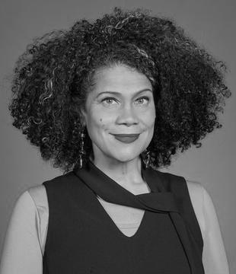
Julia Mejia
“When I look at the signs on our public beaches, everything is still very much in English.
If we are serious about creating spaces where people are seen and reflected, then translation and information justice has to be a part of that conversation.”
Boston City Councilor-at-Large

Slide 22
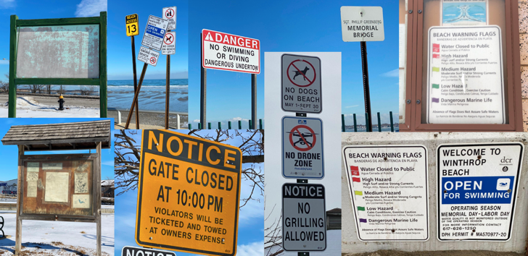
In the winter of 2022, Save the Harbor conducted a comprehensive survey of signage on the region’s public beaches in Nahant, Lynn, Revere, Winthrop, East Boston, South Boston, Dorchester, Quincy and Hull.

Slide 23
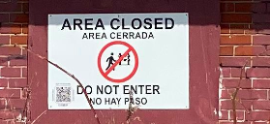
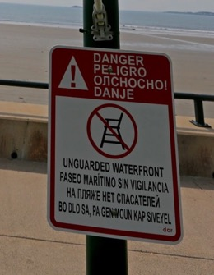
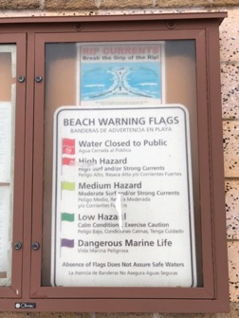
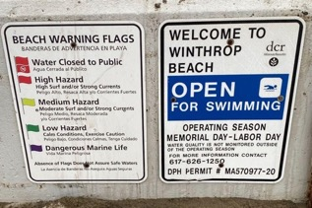
Of the 250 signs we examined, just four were in languages other than English.
Carson Beach
King’s Beach
Nahant Beach
Winthrop Beach

Slide 24
At the hearing, Acting DCR Commissioner Stephanie Cooper made a public commitment to implement multi-lingual signage using QR codes at all DCR’s beaches and parks and provide translation on their website. That process is underway.

Slide 25
We also asked the Department of Public Health to work with DCR, the MWRA and Save the Harbor/Save the Bay to improve the accuracy of their beach posting protocols, which fail to protect the public’s health.
For example, in 2021 75% of the required posts and red flags at Constitution Beach in East Boston were wrong, which is unacceptable.
This problem is exacerbated by the fact that the Department’s beach water quality website is only available in English and hasn’t been updated since 2001.

Slide 26
Though we had a productive meeting with DPH last week, they "politely declined" our request to join us today and share their thoughts on posting and flagging accuracy or their plans and timeline to make their beach water quality website available in languages other than English.
Timely and accurate information about water quality, safety, and beach regulations needs to be available to everyone, including the more than 100,000 regional residents who don't speak English as their first language.

Slide 27
Following the third hearing, the Metropolitan Beaches Commission and Save the Harbor/Save the Bay
Produced and distributed a report on Best Practices for multi-lingual signage, which you can find and translate on the MBC’s webpage at https://www.savetheharbor.org/current-mbc
Made all subsequent MBC hearing and meeting notices and press releases available at http://blog.savetheharbor.org where they can be easily translated into 109 languages using Google Translate.
Added live interpretation at all MBC hearings.
Are working with DCR, the MWRA and the City of Boston to implement best practices for multilingual signage.
Posted the FAQ’s from the Bureau of Environmental Health’s website on our blog, where they are available in 109 languages using Google Translate.

Slide 28
It’s time to hear from you.
Es hora de saber de ti.
是时候听取您的意见了。
Li lè pou w tande w.
حان الوقت للتواصل معك.
É hora de ouvir de você.
.

Slide 29
Next Steps:
MBC Hearing #4
To hear from youth and teens
Summer, 2022

Slide 30
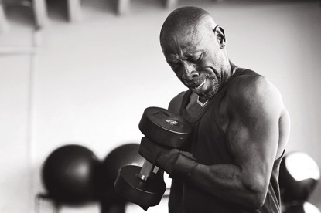
Reginald Talbert
“We really need to find more things for these kids to do in the summer.”
Site Manager
Inner City Weightlifting

Slide 31
Thanks to Co-Chairs Brendan Crighton and Adrian Madaro & the Legislative and Community members of the Metropolitan Beaches Commission, Save the Harbor/Save the Bay Board of Directors and staff, and the more than 200 people who took part in these hearings.

Slide 32
Thank to all who participated in the hearings, including Abdi Ali, Adam Bass, Rep. Adrian Madaro, Adrian Muir, Adriana Paz, AJ Capano, Aleena Mangham, Alex DeFronzo, Alice Fisher, Alicia Grimaldi, Amy Schofield, Andrea Baez, Andrea Contreras, Andrea Gayle-Bennett, Andrea Patton, Angela Ponte, Antonio Barletta, B.G. Shanklin, Barbara Bishop, Barbara Caputo Kelly, Beth Ineson, Beth Neal, Bianca Beltran, Bob Chen, Sen. Brendan Crighton, Bridget Ryan, Bruce Berman, Caitlin Stapleton, Carlos Prudencio, Carol Haney, Caroline Adamson, Charlie Jewell, Chris Goodwin, Chris Mancini, Chris Marchi, Chris Puiia, Chris Van Buskirk, Christian Merfeld, Christian R. Scorzoni, Esq., Christopher Burrell, Christopher Byner, Christopher DeFilippis, Cindy Theodore, Coleman Nee, Conor O'Shaughnessy, Craig Cashman, Rep. Daniel Hun, Daniel Kenary, Daniel Padien, Daniel West Cohen, Daria Afshar, Rep. David Biele, David Coffin, David Lee, David Spillane, AICP, RIBA, Debbie King, Deborah Rosa, Denise DosSantos, Denise Molina Capers, Dennis Conway, Donald Bossi, Rep. Donald Wong, Doneeca Thurston, Doug Newton, Douglas Gutro, Elisabeth Jackson, Elizabeth McLaughlin, Elle Baker, Ellice Patterson, Elliott Juul-Larsen, Elsa Flores, Etty Padmodipoetro, Eugene Kennedy, Gayana Daniel, Geordie Enoch, Ghizlane (Ghiz) Benzerdjeb, Gloribel Rivas, Jacqueline Chavez, Jason McCann, Jason Sandoval, JD Conte, Jenn Brundage, Jenn Meakem, Jennifer Constable, Jennifer Norwood, Jessenia Urrea, Rep. Jessica Giannino, Jessica Martinez, Jim Pitrolo, Joan Delaney, Rep. Joan Meschino, Joanne McDevitt, Joao Dos Santos, Joe Christo, John Allen, Sen. John Keenan, John Lynds, Jon Hamilton, Jonathan Thibault, Joseph Cappuccio, Joseph Gaeta, Joseph P. Newman, Joseph R. Savage, Joye Williams, Julia Mejia, Julie Pagano, Julie Simpson, Ph.D, Kannan Thiruvengadam, Karen Fernandes, Karen Pitrolo, Karen Zirkle, Kathy Lafferty, Kay Smith, Keith, Mahoney, Kristen Barry, Kristen McCosh, Kristen Wyman, Laura A. Burke, Leonard Olsen, Lindsey Santana, Lisa Larimer, Sen. Lydia Edwards, Maeve Kidney, Magdalena Ayed, Malene Welch, Maria Rodriquez, Martynas Valys, Mary Mitchell, Mary Usovicz, Maya Smith, Mayolina Mayolina, Meghan Smith, Mercy Robinson, Michael Kineavy, Michael Leon, Esq., Dr. Michael Myers, Mimi Huckins, Nicholas Bradley, Nicholas Martin, Nicole McClain, Niki Ghosh, Nikki Sanders, Nina Liang, Olivia Barker, Pam Goodman, Paola Villatoro, Patricia Salic, Sen. Patrick O’Connor, Patsy Williams, Patti Capano, Paul D. Foster, Paul Newman, Philip Chong, Ralph Decicco, Reginald Talbert, Rich Ackerman, Rita Lara, Robert Tucker, Rosa Herrero, Roxana Aguirre, Ruth Nieves, Ryan DeRoche, Ryan McGeown-Conron, Sabrina Suros, Samantha Fontenelle, Sandra Saavedra, Sara-Rose Brenner, Sarah Francis, Sean Reid, Shavel’le Olivier, Stephanie Burke, Stephanie Cooper, Stephanie Ortha, Susan Hamilton, Susan Tracy, Rep. Tackey Chan, Thomas N. O’Brien, Tiffani Caballero, Tom Cox, Tom McCarthy, V Mon, and Veronica Robles.

Slide 33
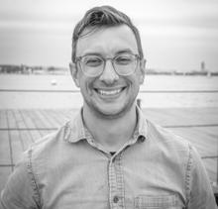
Chris Mancini
“As an environmentalist I have come to value biodiversity as a measure of the health of an ecosystem.
As an advocate for justice and change, I see diversity on our beaches as an important measure of the health of our community.”
Executive Director,
Save the Harbor/Save the Bay

Slide 34

Thanks for joining us today.
Enjoy Father's Day &
Have a Happy Juneteenth!
Comments, suggestions, questions?
Info@savetheharbor.org

