Slide 1
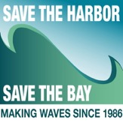
CURRENT & Best Practices
MultiLingual Signage And Websites
Bruce Berman
Director of Strategy & Communications
Save the Harbor/Save the Bay
Caroline Adamson, Masters Candidate
Boston University School of Public Health, Save the Harbopr/Save the Bay
Notes:
Hi everyone, thank you for being here with us this morning. I want to take the opportunity to thank Save the Harbor/Save the Bay and the Metropolitan Beaches Commission for giving me the opportunity to take a deep dive into the important issue of multilingual resources for our communities. We are all here today with a shared understanding of the importance of our public beaches as recreational resources. With this in mind, let’s take a look at the resources community members may encounter when attempting to utilize the public beaches. Bruce,
At Save the Harbor/Save the Bay, we are concerned with increasing accessibility to our regions beautiful and clean beaches. These are major recreational resources and it’s important that each individual in the area has an equal opportunity to take advantage of them. With this in mind, we have identified language barriers as an obstacle that our community members may face when hoping to utilize our beaches.
The purpose of this presentation is to examine the existing multilingual resources made available by the Department of Conservation and Recreation, the Department of Public Health, and the Department of Marine Fisheries, while also taking a look at some inspiring resources from around the Country.

Slide 2
549,000
125,000
35,000
24.7% of Massachusetts residents speak a language other than English in their home
Residents speak Spanish
Residents speak Mandarin or Cantonese
Residents speak Arabic
Notes:
Source: https://statisticalatlas.com/state/Massachusetts/Languages - Note - data for Bostin Metro is not reliable - and these resources belong to everyone.
Big picture: Our communities are diverse and it is vital to the health and wellbeing of individuals to distribute this important information in a way that people who speak multiple languages would all understand
We’ll be looking at three areas of information - beach rules and regulations, water quality, fishing regulations for both on-site signage and websites/online resources

Slide 3
We have had productive conversations about the importance of multilingual outreach, materials, signage & websites with DCR, DPH, DMF, MWRA, the MSP and the MEP. They have all acknowledged the importance of this effort & reaffirmed their commitment to address these issues in an efficient and timely manner.

Slide 4
BEACH Signage
We conducted a comprehensive survey of current signage at the Metropolitan Region’s public beaches from Nahant to Nantasket.

Slide 5
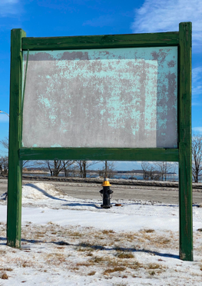
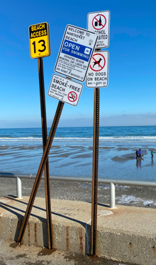
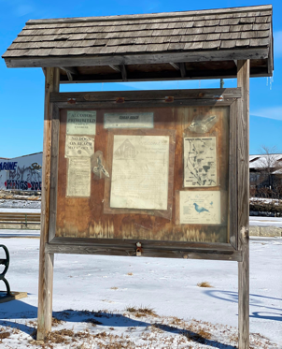
Malibu Beach
Nantasket Beach
Tenean Beach
MaNY NEED TO BE REPAIREd OR REPLACED

Slide 6
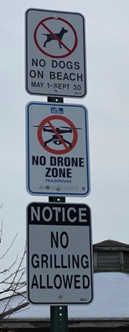
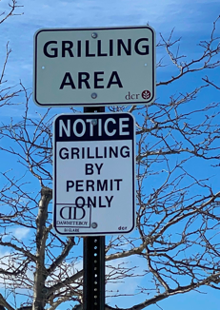
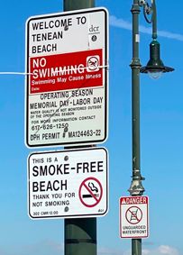
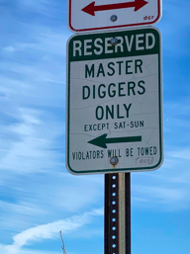
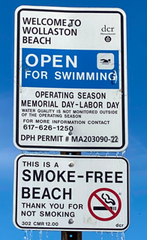
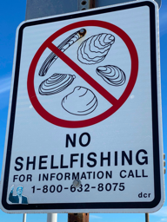
Tenean
Beach
Carson Beach
Wollaston Beach
Malibu Beach
Constitution Beach
Wollaston
Beach
Messaging is Inconsistent

Slide 7
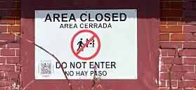
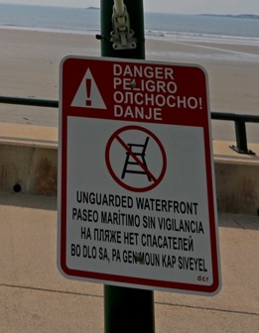
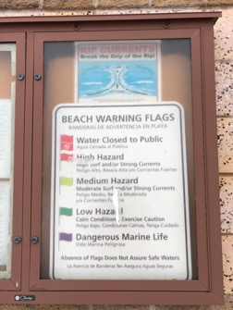
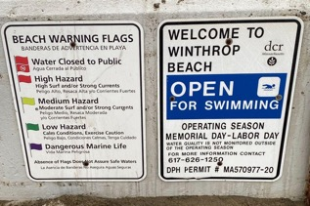
Of the more than 250 signs we examined just 4 were in languages other than English.
Carson Beach
King’s Beach
Nahant Beach
Winthrop Beach
Notes:
Some information is essential and needs to be fixed immediately

Slide 8
Information about beach water quality, including current beach postings, is in English only, putting the public’s health at risk.

Slide 9
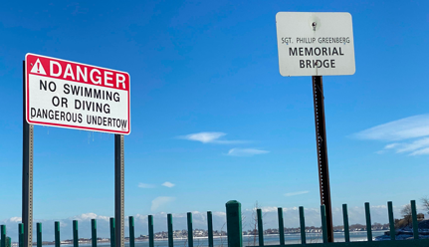
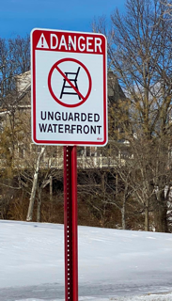
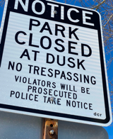
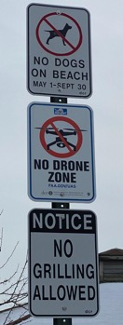
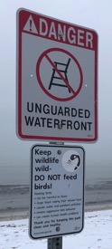
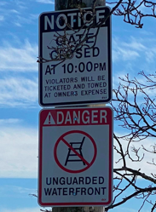
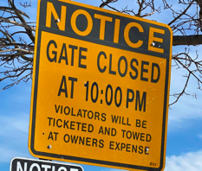
Raising Serious Public Safety Concerns
Notes:
wollaston, no lifeguards, unguarded waterfront, time that lots close

Slide 10
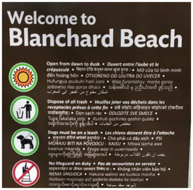
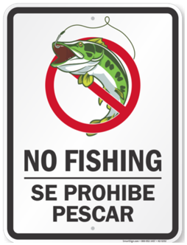
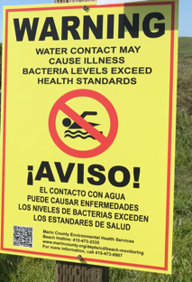
Best Practices: Signage
Beach Rules & Regulations
Saltwater Fishing Regulations
Water Quality
Burlington, VT uses the same design for their multilingual signage across the entire city.
Bilingual sign in Point Reyes, CA. uses QR code function.
Bilingual sign in Point Reyes, CA. uses QR code function.
Simple, bilingual no fishing sign.
Notes:
Beach rules and regulations:
Devin Grammon at the University of Oregon Study found:
-Signs with proper spanish grammar will provide more accurate translations
-Using similar typography for multiple languages - so languages are equally visible
-Including welcoming signs in addition to the prohibitory and regulatory signs
Source: https://www.klcc.org/education/2020-05-20/uo-spanish-professor-suggests-ways-to-make-bilingual-signs-inclusive-in-downtown-eugene
Blanchard beach source: https://enjoyburlington.com/city-wide-signage-installation/
“Multi-lingual rules and regulations signage at all of our public beaches, City Hall Park, and Roosevelt Park ensure everyone knows the Park rules.”
These signs are uniform throught the city through its design, providing cohesiveness between all the information
Soofa could be a resource here in aiding to create multilingual signs like the one in Burlington VT… they already have a relationship established with the city of revere:
https://www.smartcitiesdive.com/news/revere-massachusetts-coronavirus-soofa-communications-opioid-epidemic/578344/
Water quality:
Notable in this on-site example is the QR code on the sign, this allows individuals to scan and be linked to more information or information in their language
https://pacificsun.com/marin-county-posts-then-removes-bacteria-warning-signs-at-point-reyes-beaches/
Saltwater fishing regulations:
The New Mexico Department of Game and Fish are concerned with the potential of accidentally introducing aquatic invasive species to their waters from boats returning from contaminated waters. They regularly run boat inspection checks. This is a sign that they originally posted at two points and created plan to put at least 10 more up in order to ensure this information is communicated to as many individuals as possible.
https://magazine.wildlife.state.nm.us/department-unveils-first-ever-bilingual-aquatic-invasive-species-signs/

Slide 11
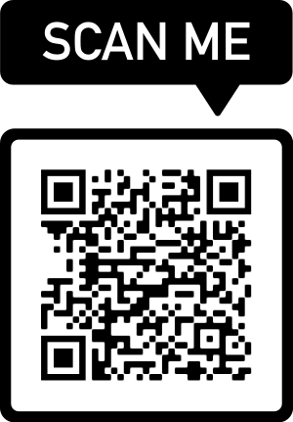
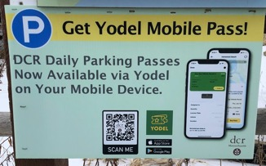
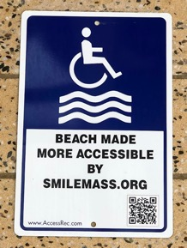
DCR uses QR codes for parking passes and other purposes.
Notes:
QR code to blog post with media advisory

Slide 12
Websites & resources
We have had productive discussions with DCR, DPH, DEP, DMF, MWRA, other state agencies and our beachfront communities and are working together to develop strategies to improve access to these spectacular urban natural resources for people of all languages and backgrounds.

Slide 13
Beach Rules and Regulations
DCR website uses Google translate
Online resources only in English

Slide 14
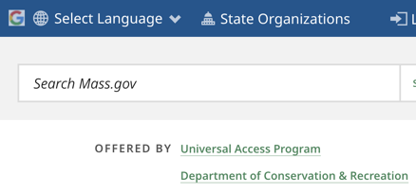
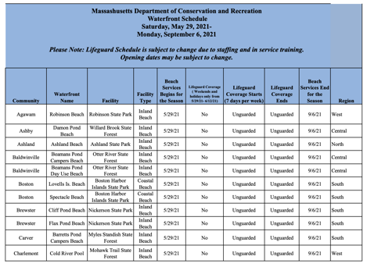
Beach Rules and Regulations: Existing Multilingual Resources
The entire DCR website can be translated using Google translate.
However, helpful resources are only available in English.
Notes:
Revere beach sign: https://www.gettyimages.com/detail/news-photo/signs-promote-covid-19-safety-at-revere-beach-in-revere-news-photo/1228006289?adppopup=true
DCR site: https://www.mass.gov/saltwater-ocean-beaches
From DCR website: https://www.mass.gov/doc/waterfront-services-at-dcr-managed-swimming-locations-0/download
But according to this release:
https://www.mass.gov/news/baker-polito-administration-files-legislation-to-improve-safety-awareness-discourage-swimming-at-undesignated-state-waterfronts
“DCR welcomes visitors of all ages and swimming abilities to our waterfronts each summer season, and we ask that each person heed park signs, staff direction, and water safety recommendations,” said DCR Commissioner Jim Montgomery. “The increase in fines for swimming in unsafe waters on DCR property is another example of the Administration’s continued commitment to increasing safety throughout our state park system.”
How can this information be communicated without bilingual signage?
There is multiple languages only at select sites according to the report.

Slide 15
Saltwater fishing regulations
DMF website uses Google translate
Amazing fishing resources online are only in English

Slide 16
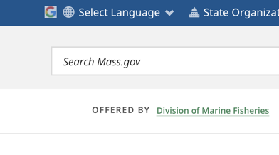
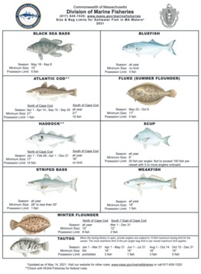
Saltwater Fishing Regulations: existing Multilingual Resources
Helpful fishing resources are available for free on the DMF website, however, these resources are only offered in English.
The entire DMF website can be translated using Google Translate.
Notes:
No multilingual on site signage was identified
Additionally, the DMF website is able to translate using the google translate function, this is great, however, the many helpful resources also available on the site are not translated. There are fines and penalties associated with each fish, it is unfair to impose these regulations on individuals who are not even aware of them because fish names don’t translate well between languages
https://www.mass.gov/service-details/recreational-saltwater-fishing-regulations

Slide 17
Water quality
Though the Department of Public Health’s website uses Google Translate, their Bureau of Environmental Health’s beach water quality website is available in English only and needs to be updated.

Slide 18
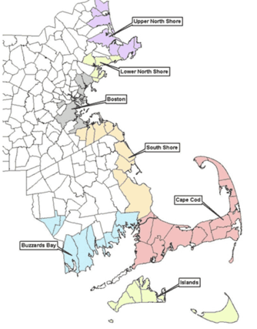
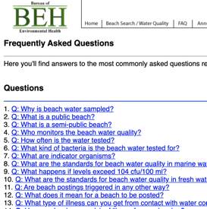
Water Quality: Existing Multilingual Resources
Resources on the DPH website are only accessible in English.
Notes:
During July of 2021 there was multilingual signage pictured at King’s Beach. We see signs in both English and Spanish, however, the spanish sign does not have information about potential bacteria in the water, which is important information to provide to community members. Also, without the English and Spanish signs being posted next to each other, how can one be sure that the necessary information reached individual community members regardless of their primary language?
Source: https://www.bostonherald.com/2021/07/16/11-million-gallons-of-untreated-wastewater-poured-into-north-shore-beach-over-july-4th-weekend/
Additionally, DPH puts out a website where you can access recent water quality information and easily filter for results using the beach name or town. This page also has a useful FAQ question that explains water quality testing, however, none of this information is translated into a secondary language, making it inaccessible to non-english speakers.
DPH site: https://ma-beaches.healthinspections.us/beaches.cfm?showsearch=1

Slide 19
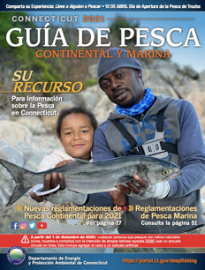
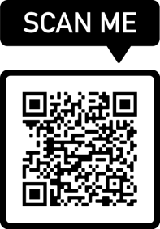
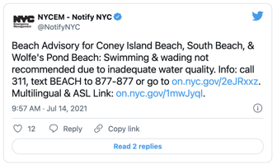
Best Practices: websites and Digital resources
Live updates for Staten Island beaches are provided through their Twitter account with a link to multilingual resources.
CT’s “going digital” movement has allowed the state to create resources available in multiple languages.
QR codes are an incredibly easy way to direct people to multilingual resources.
Notes:
QR code -
Social media - “Communicating with the City through social media further enables customers to contact the City in a direct and meaningful way.”
Going digital - “ The benefits to “going digital” are many—convenient, immediate access to information from nearly anywhere; the ability to include multiple languages; the ability for real-time updates as regulations change or new areas open; increased relevance to the next generation of outdoor enthusiasts; and elimination of thousands of unused copies that end up being recycled or worse, simply disposed of. The option of having shorter PDF versions that can be printed for users if needed will help ease the transition.”
Beach rules and regulations: QR
Water quality: social media
Staten Island issues alert through their twitter account and provide link to multilingual information: https://www.silive.com/news/2021/07/due-to-high-levels-of-bacteria-swimming-not-recommended-at-2-si-beaches-city-says.html
https://www1.nyc.gov/site/em/resources/notify_nyc/public-health-2.page < multilingual link
Additionally, the Rhode Island Department of Health Website promotes the Beach Monitoring Program which enables all of the beach results to be translated using google translate (similar to the functions that the DCR and DMF websites for MA have). The website also features a box in the top left corner that allows for access with incredible ease to the most up to date information. This box also translates when the entire sit is translated using the google translate function.
https://health.ri.gov/programs/detail.php?pgm_id=119
Saltwater fishing regulations:
Connecticut has a “going digital” movement where they have stopped printing resources and only post them online, this allows them to make the information available in multiple languages
https://portal.ct.gov/DEEP/Fishing/General-Information/Fishing-Guide

Slide 20
We all understand the importance of this issue and acknowledge the difficulty surrounding solutions. Google Translate is a great start, though it can be hard to implement and imperfect in its translations. Though physical signage is expensive, it is critically important and needs to be maintained.

Slide 21
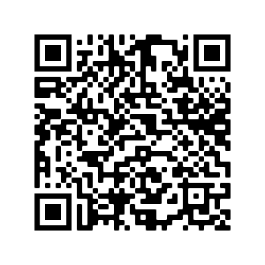
Thank you.

